Slide 1
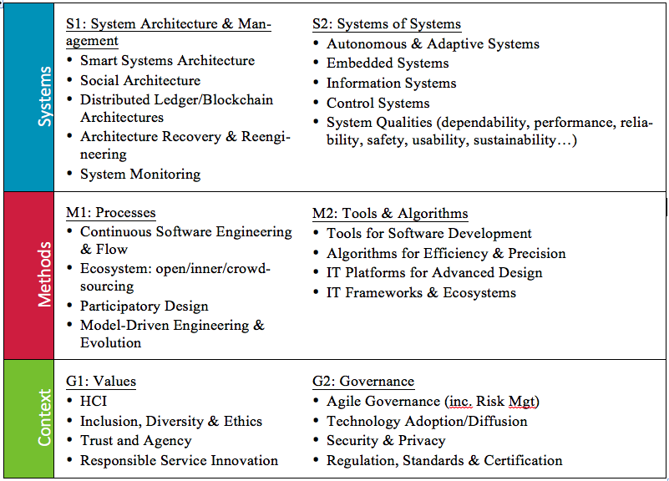
Lero Research Strands

Slide 2
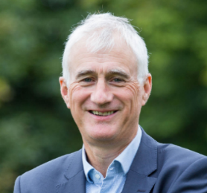
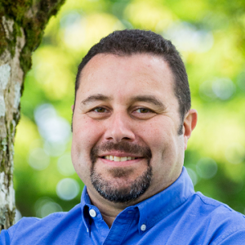
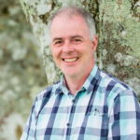
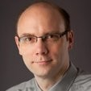
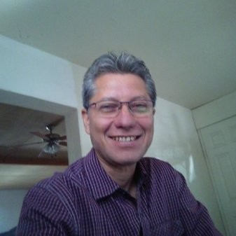
MANAGED
Defined/Repeatable
Evidence-driven
Continuous/Flow
Automated
Trustworthy Software Process
TRANSPARENT
Traceable
Open
Trustworthy Software
Accountability
SECURE
@design time
adaptive@run time
Brian Fitzgerald
Bashar Nuseibeh
Jim Buckley
MODERNISED
Not frozen legacy
Reusable/recommender
Trustworthy Software Product
VERIFIABLE
Clean code
ETHICAL
For world we want - societal & environmental values
Goetz Botterweck
Enrique Naredo

Slide 3
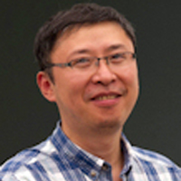
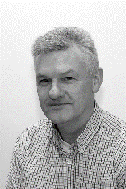
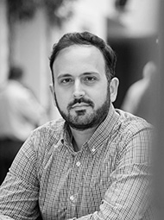
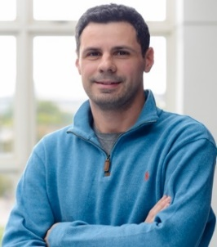
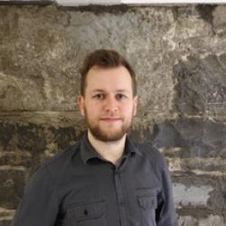
MANAGED
Defined/Repeatable
Evidence-driven
Continuous/Flow
Automated
Trustworthy Software Process
TRANSPARENT
Traceable
Open
Trustworthy Software
Accountability
SECURE
@design time
adaptive@run time
Bashar Nuseibeh
Yijun Yu
Tom Newe
MODERNISED
Not frozen legacy
Reusable/recommender
Trustworthy Software Product
VERIFIABLE
Clean code
Vasileios Koutavas
Giovanni Russo
Paddy O Conbui
ETHICAL
For world we want - societal & environmental values

